Slide 1
Medical Image Enhancer Using GAN’s

Slide 2
Agenda
Introduction
Literature Survey
Problem Statement
Objectives
Experiments Carried
Proposed Methodology
Results
Conclusion
References

Slide 3
Introduction
In this work, a Siamese GAN paired with a sequential layer in the generator will be used. The Siamese network significantly reduces the labeling cost and increases the scalability of the method to get higher resolution images. After that, these images will be used to train the object detection model as well as make a dataset for future tumor detection models.
Further, the output images are analyzed by passing them through an object detection model trained to find tumors. It is then checked against traditional enhancements as a form of comparison

Slide 4
Literature Survey

Slide 5
Title | Technique | Drawback | Remarks
Learning More with Less: GAN based Medical Image Augmentation Han et al. (2019b) (2019 | Used traditional GAN architecture to increase resolution | Low output accuracy, higher number of untrue tumor detection | Binary pairwise label information (Siamese) can be used to increase accuracy.
iGAN: Siamese Generative Adversarial Network for Identity Preserving Face Hallucination Hsu et al. (2019) (2019) | Siamese GAN for increasing resolution of images of human faces | Initial epochs output only random data as GAN outputs noise | Need to optimize speed of training and hence increase accuracy after same training time

Slide 6
Title | Technique | Drawback | Remarks
Super-Resolution using GANs for Medical Imaging Gupta et al. (2020b) (2020) | GAN-CPCE and GAN-CIRCLE architecture to detect with tumors | Low accuracy and true label loss | CPCE and CIRCLE can be imbibed into other architectures with better accuracy
Medical Image Synthetic Data Augmentation Using GAN Zhang et al. (2020) (2020) | PG-ACGAN; a PGGAN and ACGA | Lack of modal data | PG-ACGAN gives high accuracy

Slide 7
Problem Statement
The literature study shows that the gap that has to be bridged is increasing resolution while retaining high true accuracy. True accuracy, as opposed to relative accuracy for model creation, can be defined as the actual presence of tumors. Two main approaches are utilized to do this; first, the data collection is translated into a usable form using binary paired labels. This enables us to employ a Siamese network generator rather than a conventional generator. The rationale for this is to instantly verify inaccuracy in created pixels using a comparator image (the second image passed through).

Slide 8
Objectives
In this work, a Siamese GAN paired with a sequential layer in the generator is used. The Siamese network significantly reduces the labeling cost and increases the scalability of the method to get higher resolution images.
We aim to use the proposed new architecture to increase resolution with greater accuracy. After that, these images will be used to train the object detection model as well as make a dataset for future tumor detection models.

Slide 9
Experiments Carried
Firstly, we have pre-processed the image dataset that we have received from the Kaggle.
Secondly, we have transformed these low resolution images to Super Resolution Images with the help of our proposed architecture.
Thirdly, we have used this super resolution dataset, low resolution dataset and the normal dataset to predict the tumour and analyzed the results.

Slide 10
Proposed Methodology
The following flow diagram, shows the overall workflow of our model. We send in a low resolution scan through our GAN. The high resolution image is then sent through a SOTA object detector which predicts the presence of a tumor.

Slide 11
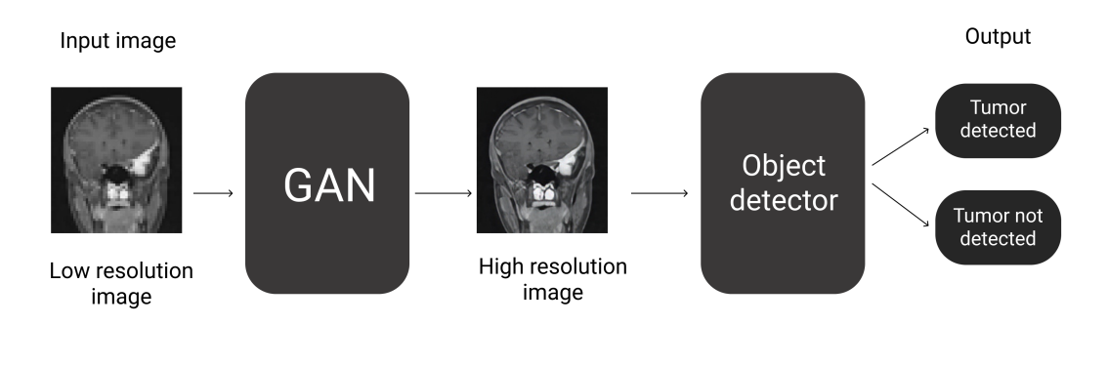

Slide 12
Low Level Design
The GAN model consists of 2 twin generators. The generator pair is used to increase the resolution of the given medical image pair. The output is fed into a pre-trained sequential network which increases resolution.
This is useful in increasing the speed and accuracy of generator output. The output of the sequential layer is sent into a discriminator which distinguishes the produced image with the high resolution images.
It then predicts whether the input image is fake or real. A feedback is generated to the generator to improve its output. This continues in the normal adverserial format until the discriminator is no longer able to distinguish between the real and fake images.

Slide 13
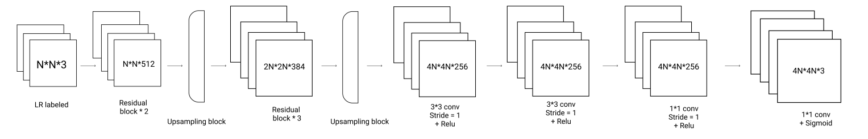
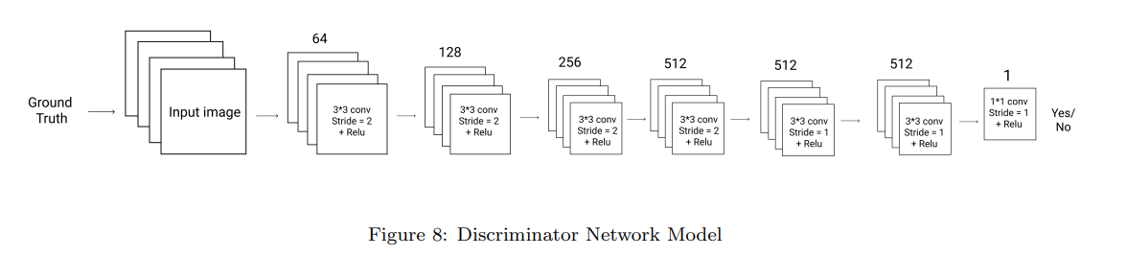
Generator Network Model
Discriminator Network Model

Slide 14
Results
The image on the left shows the image from the normal dataset. The image in the center is a low resolution version of the same image. This image is then passed through the GAN and we get the third image of the row as an output.
The visual improvement of image three in all rows stands out and shows the quality change we can achieve from a low resolution image via SeSiGAN.

Slide 15
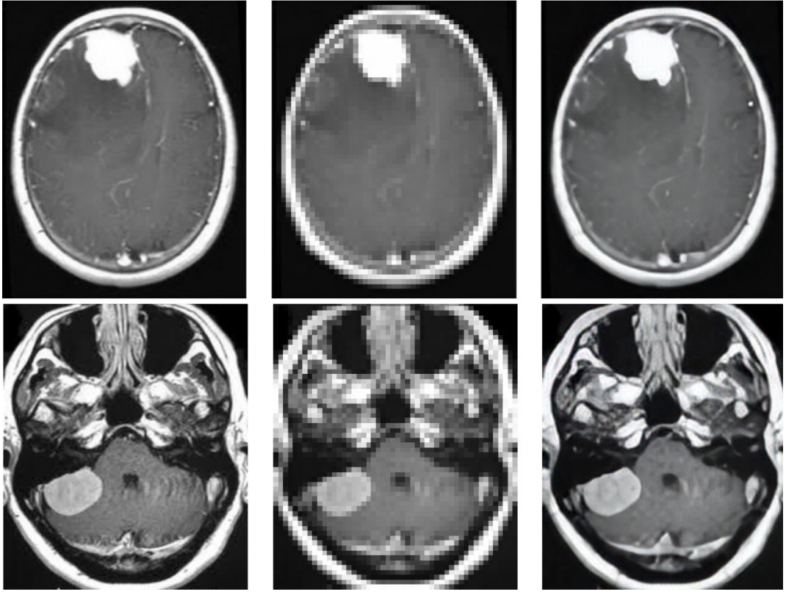

Slide 16
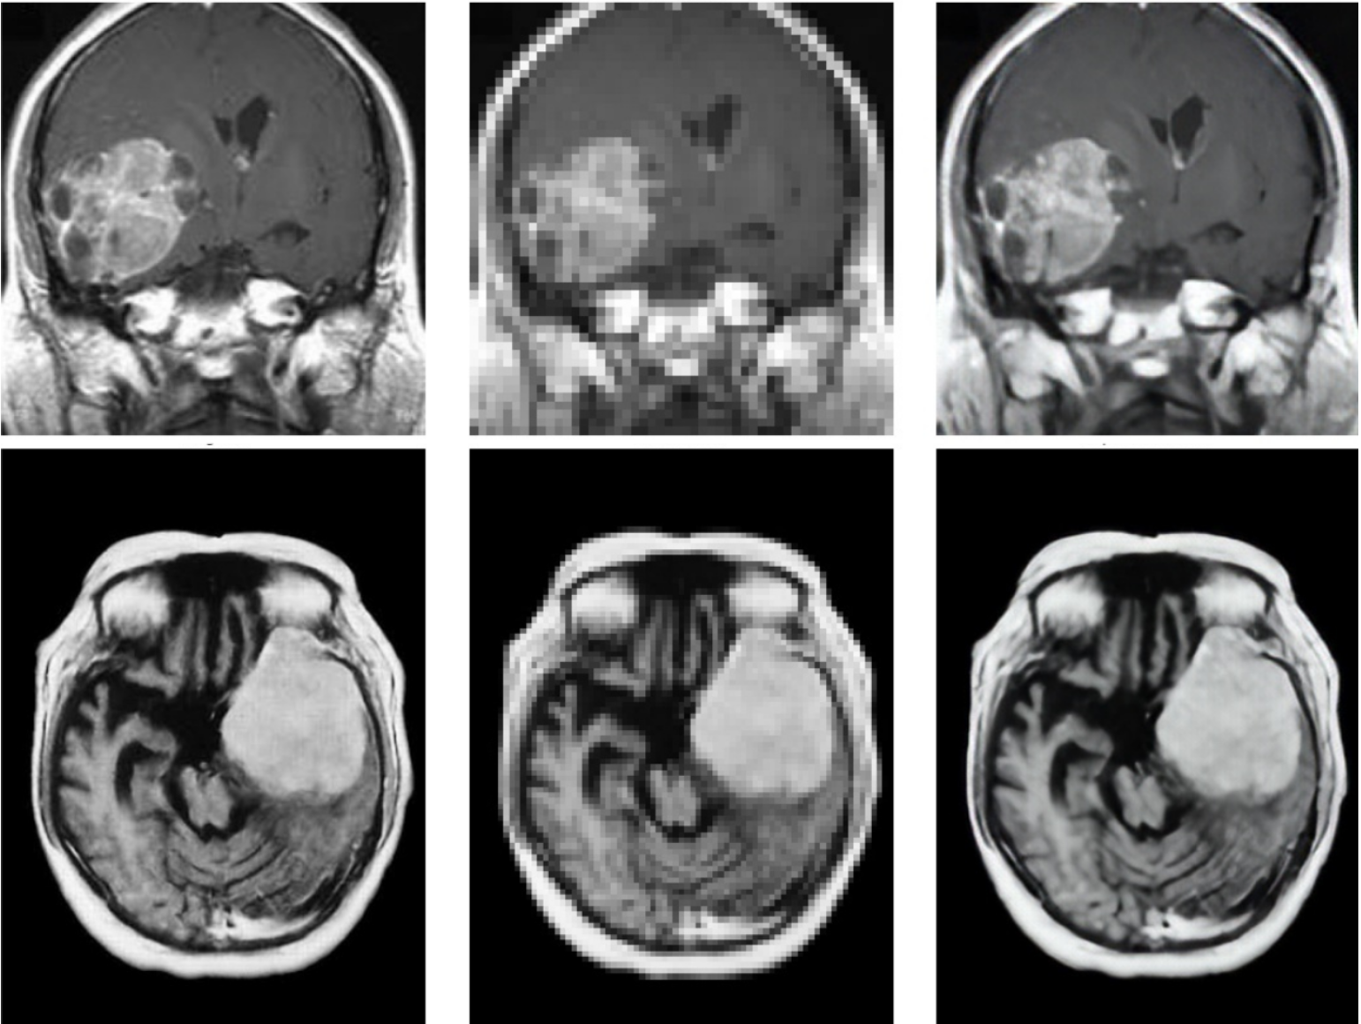

Slide 17
Dataset Comparison:
The accuracy of the model trained on Low resolution images was the lowest amongst the three with the model trained on Super resolution images being the highest. The accuracies of the models trained on the Normal dataset and the Super resolution from the Low resolution images dataset are comparable.

Slide 18
Conclusion
We proposed a novel GAN architecture to obtain super resolution medical images. The proposed network encompassed current standard architectures while fixing gaps left to achieve true accuracy. The results of the detection are compared with 3 other datasets which are used to train the same model; the original dataset, the low-resolution dataset and the super resolution dataset made from the low-resolution dataset. The outcome of the comparison was that the super resolution dataset yielded the highest accuracy of 99.89%.

Slide 19
References
[1] Changhee, H., Kohei, M., Shin’ichi, S., & Hideki, N. (2019). Learning more with less: GAN-based medical image augmentation. Med. Imaging Technol, 6.
[4] Zhang, H., Huang, Z., & Lv, Z. (2020, October). Medical image synthetic data augmentation using gan. In Proceedings of the 4th International Conference on Computer Science and Application Engineering (pp. 1-6).
[2] Hsu, C. C., Lin, C. W., Su, W. T., & Cheung, G. (2019). Sigan: Siamese generative adversarial network for identity-preserving face hallucination. IEEE Transactions on Image Processing, 28(12), 6225-6236.
[3] Gupta, R., Sharma, A., & Kumar, A. (2020). Super-resolution using gans for medical imaging. Procedia Computer Science, 173, 28-35.

